Slide 1

Trauma Facility Helicopter Safety and Landing Zone Training

Slide 2
INTRODUCTION
The GETAC Air Medical Committee is responsible for affecting and supporting safe air medical operations and high-quality clinical care provided by air medical transport services in Texas.
This committee provides guidance in the development and review of hospital and pre-hospital assessment tools, regional plans, treatment guidelines, and the committee SOP.

Slide 3
INTRODUCTION
The following content has been developed to fulfill requirement (h)(6) of the Texas Administrative Code Chapter 157, Rule 157.126 Trauma Facility Designation Requirements which will be effective on September 1, 2025 and states:
“Facilities must have landing zone capabilities or system processes to establish a landing zone (when rotor-wing capabilities are available) with appropriate staff safety training.”

Slide 4
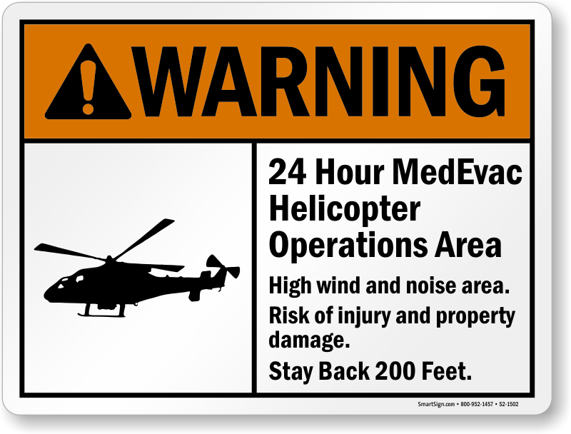
OBJECTIVES
The #1 objective of this training is to ensure Safe Helipad Operations and to PROTECT
  Patients
  Flight crew
  Hospital staff and,
  The public

Slide 5
OBJECTIVES
Identify landing zone requirements.
Identify safety practices and security around an aircraft and within the landing zone.
Define FOD and your role in preventing FOD damage to aircraft.
Identify factors to consider when preparing your patient for air transport.
Define “EMS Timeout” and identify its critical components.
Define your role in the Texas EMS Wristband Project
Recognize additional considerations during night operations.

Slide 6
DISCLAIMER
This presentation is a state-wide, universal training for educational use only; this presentation does not provide a substitute for any agency-specific education or training.
We strongly encourage reaching out to your local air medical providers for further guidance.

Slide 7

SAFETY
The number one priority for any air medical operation!
Safety applies to both those inside and outside of the aircraft.
Vigilance is required by those on the ground and in the aircraft during take-offs and landings.
LZ team members must eliminate all non-essential distractions (i.e., phones, cameras, etc.). Those responsible for the safety and security of the LZ should not engage in photography or videography during the landing and departure of the aircraft.

Slide 8
LANDING ZONE REQUIREMENTS
Safety begins before the aircraft arrives!
Most facilities have a helipad or designated LZ. If not, these are the requirements for an unplanned LZ.
Area should be a minimum of 100’x100’ with no overhead obstructions.
Area surrounding LZ should also be as free as possible from obstructions/hazards.
Area should be a flat and level surface – 3-degree grade or less with little to no slope, as well as firm with no hidden obstacles.
The area’s surface should be paved, short grass, or hard packed dirt that does NOT create dust. Brownouts caused by dust can be catastrophic.

Slide 9
CONTINUED LZ REQUIREMENTS
Safety begins before the aircraft arrives!
Foreign Object Debris (FOD) is any unsecured object in or around the LZ. It can be anything from rocks and trash to stretchers, sheets, and hospital bed mattresses.
During take-off & landing, FOD can be lifted by rotor wash and sucked into the engine, main or tail rotor, causing catastrophic damage.
Areas surrounding LZ, such as open truck beds, should also be as free as possible from loose material.
The area should be inspected prior to every landing.
Restrict bystander access to the area. Blown FOD can become dangerous projectiles.

Slide 10
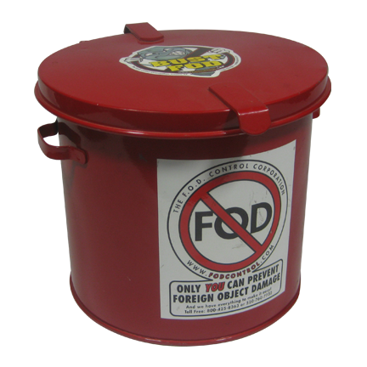
FOD Prevention
Safety begins before the aircraft arrives!
Foreign Object Debris (FOD) can put an aircraft out of service and leave it blocking the helipad until it can be repaired.
This could prevent other patients from coming in or transferring out.
On elevated helipads, unattended equipment or stretchers could be blown off causing injuries below.
Security should do a daily FOD check, or at minimum, before each landing.
If you have a windsock, ensure that it is in functional condition. If not, contact your local provider for help in obtaining a new one.

Slide 11
MULTI AIRCRAFT CONSIDERATIONS
LZ requirements are designed for a single aircraft.
Helipad safety area, in most cases, extends past the concrete pad or designated LZ due to the rotor wash of an arriving or departing aircraft.
If landing multiple aircraft, an additional LZ will be needed. Hospital security must ensure an adequate safety area is available between each LZ.
  For example, two established LZs may require an additional 100’ in between them for the safety area.

Slide 12
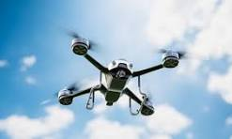
SAFETY - DRONE OPERATIONS
An unmanned aircraft system (UAS), sometimes called a drone, is a safety risk to aircraft and should not be operated in the vicinity of air medical operations.
Some hospital systems are utilizing drones to courier medications, supplies, and other items around large facility campuses.
If you observe a drone in the vicinity of the LZ, immediately notify hospital security and the incoming helicopter’s communication center and if possible, request the drone operator to shut down the drone until the helicopter has safely departed the area.

Slide 13
PREPARING YOUR PATIENT
FOR TRANSPORT
General Considerations
Consider the outside weather- Although aircraft are equipped with AC and heat, it can still get hot/cold during transport. Have extra blankets available or remove excessive clothing if needed.
More than one IV site preferred. When loading the patient into the aircraft, do not utilize IV poles. Keep IV bags below the level of your head.
Ensure all lines and tubes are well secured- There will be a lot of pt movement during loading/unloading, and things can become dislodged easily.
Remove or secure any loose items such as clothing or bandaging- Items that can get sucked into the rotor system.
If applicable, ensure the patient is decontaminated according to Safety Data Sheet (SDS) standards.

Slide 14
MOVING YOUR PATIENT
General Stretcher Considerations
Facilities should work with local Air Medical Providers as certain patient conditions may require a deviation from the following recommendations:
Types
Hospital bed
EMS-style stretcher
Requirements
Stretcher and/or hospital bed should receive routine and ongoing maintenance to ensure safe and proper working condition
  Functional brake, steering system, and ability to raise and lower to full capability
  Dual-sided locking rails and 3-point straps if using an EMS stretcher
  With or without a secured mattress based upon crew discretion

Slide 15
PREPARING FOR ARRIVAL
Gear Up! Wear safety glasses and hearing protection.
Assign a tail rotor guard and/or LZ safety officer (This needs to be someone not actively involved in the pt treatment).
Ensure the area is secured and there are no pedestrians, animals, or vehicles within or immediately adjacent to the landing area
Walk the area and remove any FOD that could be easily blown around when the aircraft arrives.
Observe for any possible obstructions around the landing area. If you see something, say something!

Slide 16
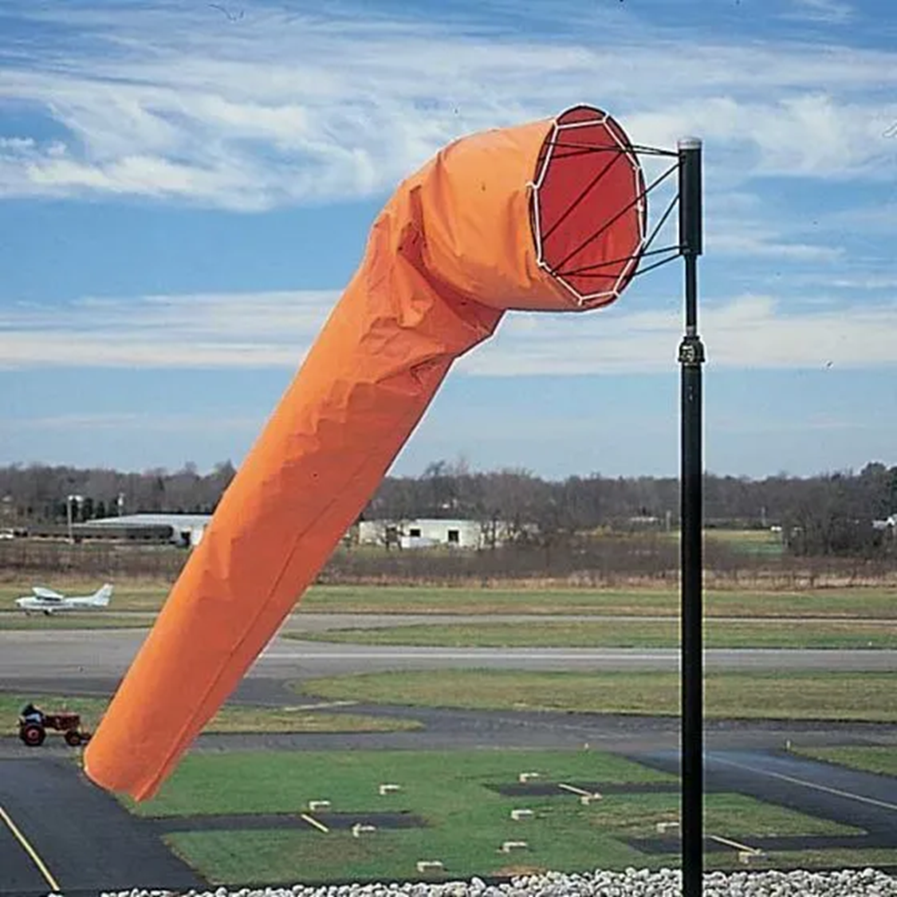
LANDING
Anticipate extremely high winds!
Landing will almost always be done with the helicopter approaching into the wind.
Maintain security within and around the landing area.
A tail rotor guard is essential when the helicopter is on the ground and running.
DO NOT approach the aircraft while it is running unless accompanied by the flight crew and/or only when directed to do so.

Slide 17
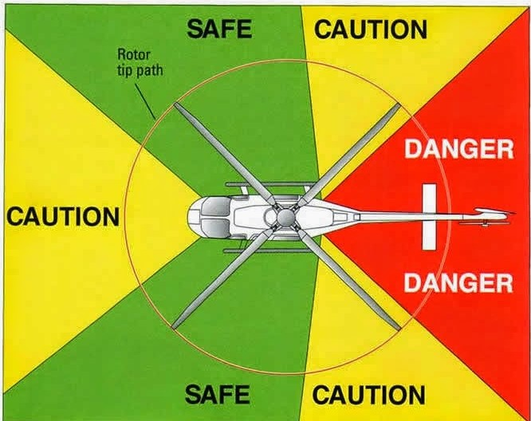
APPROACHING
THE AIRCRAFT
DO NOT enter the area unless accompanied by the flight crew and/or only when directed to do so.
Utilize minimal amount of personnel needed to safely load or unload.
Remove any hats or loose items from your person.
Enter/exit in the area shown in green after receiving approval from the pilot or flight crew.
NEVER approach from the tail!
Notes:
Ensure you depart the same path as you entered

Slide 18
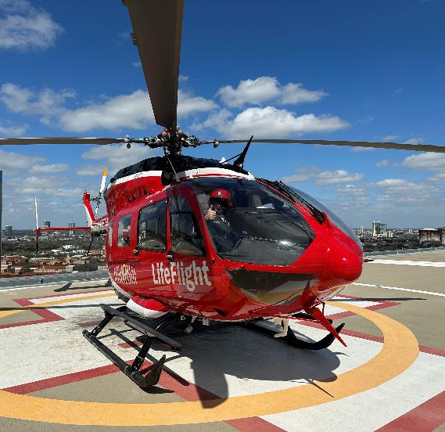
APPROACHING THE AIRCRAFT
If you must approach the aircraft, follow the steps below:
  First obtain permission from the flight crew.
  Confirm the pilot is aware of your approach.
  Wait to approach until the pilot indicates it is safe to do so (make eye contact with the pilot and wait for approval, i.e. thumbs up).
Notes:
Ensure you depart the same path as you entered

Slide 19
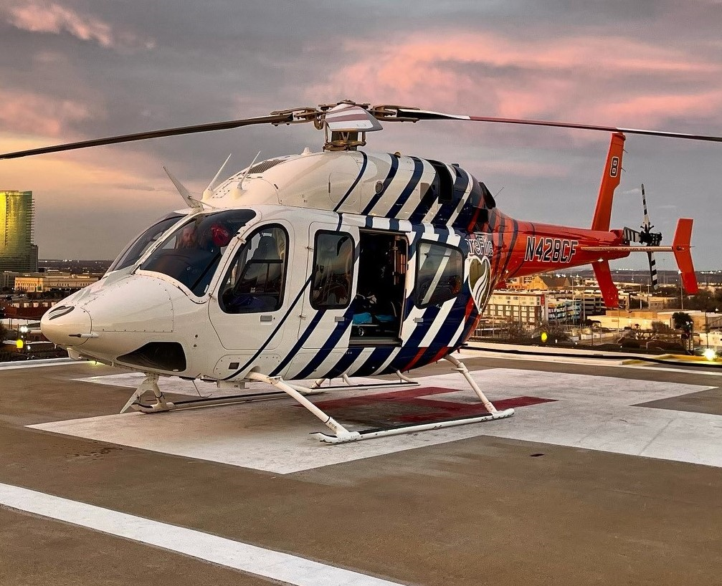
SITUATIONAL AWARENESS
Look first!
  Think through what you are about to do.
  Think through where you are about to go.
  Move slowly and intentionally.
  Always be aware of what the aircraft is doing and is about to do.
Notes:
Ensure you depart the same path as you entered

Slide 20
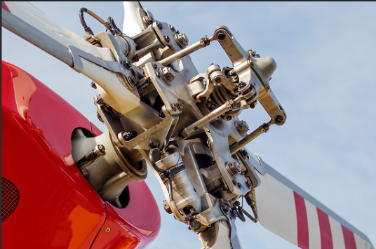
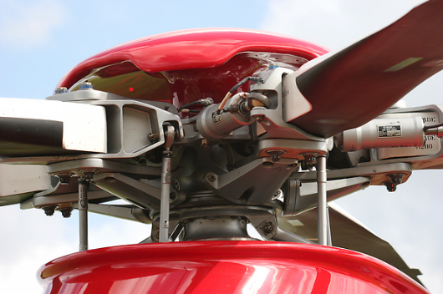
LOADING/
UNLOADING
Assisting the flight crew with loading/unloading a patient will always be at the discretion of the flight crew. If requested to assist, all stretcher/sled movement will be directed by flight crew.
Cold Loading/Unloading
Loading/Unloading is done when the engine is shut off and the blades have completely stopped turning.
Safer, more controlled
Hot Loading/Unloading
Loading/Unloading is done while the aircraft is running
More common during scene responses
Will always be at the flight crew's discretion as there are multiple factors involved in this decision

Slide 21
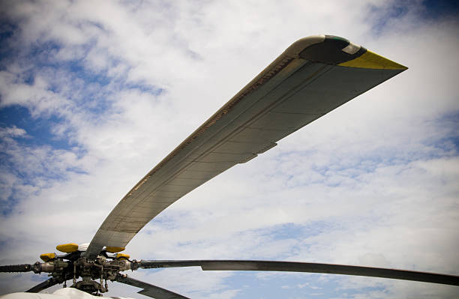
SAFETY NOTE
Rotor droop is caused when an aircraft is shut down, but the main rotor is still slowing/spinning to a stop. In this situation, the rotor blade tips can drop dangerously close to the ground.
NEVER approach a shut-down helicopter whose main rotor is not completely stopped. Wait until the flight crew marshals you, indicating it is safe to approach the aircraft.

Slide 22
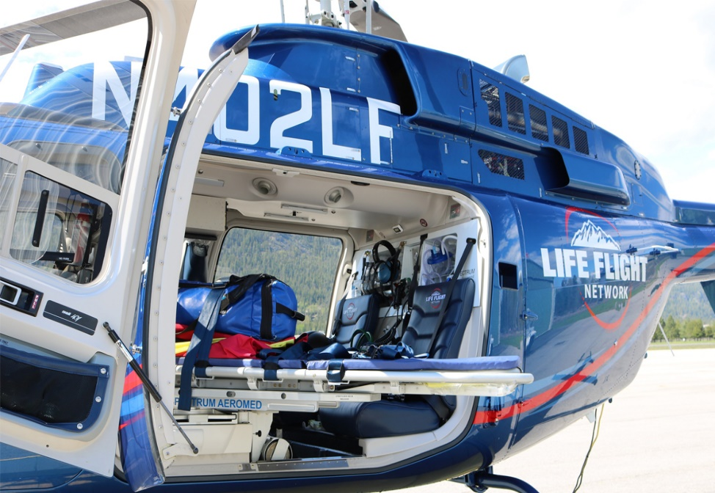
LOADING/
UNLOADING
Aircraft Doors and Equipment
Doors are light and fragile – Do not attempt to open, close, or secure the aircraft doors. Leave that to the flight crew!
Do not rest hands on or lean against the aircraft – burns can occur from unsuspected hot surfaces (pitot tubes, cowlings, etc.).
Antennas and sensors accidentally bumped can damage the aircraft and cause out of service time.
Do not touch or move any aircraft support gear (land lines, chocks, foxcarts, etc.)

Slide 23
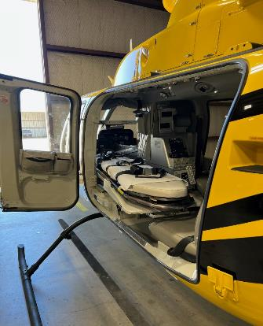
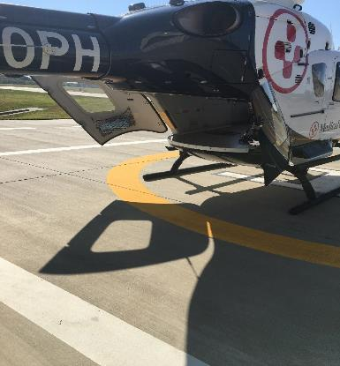
LOADING/UNLOADING
Side Load
Rear Load

Slide 24
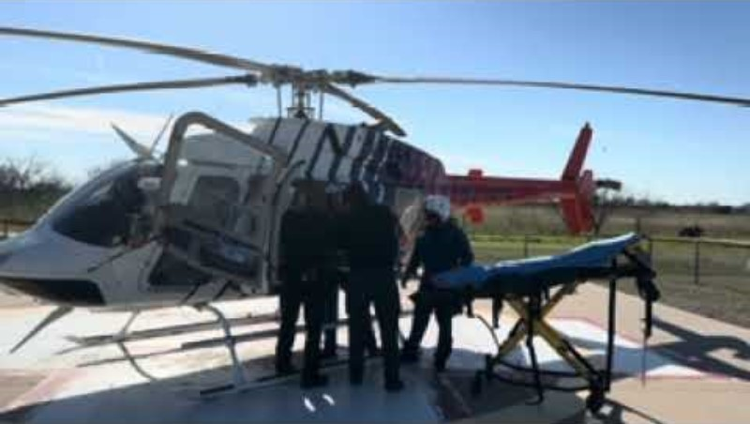
LOADING/UNLOADING
Click to view the following videos of loading and unloading various airframes.
Loading - Bell 407

Slide 25
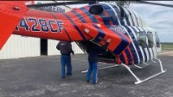
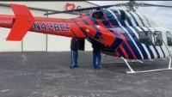
LOADING/UNLOADING
Loading - Bell 429
Unloading - Bell 429

Slide 26
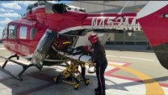
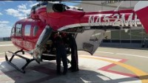
LOADING/UNLOADING
Loading - EC 145
Unloading - EC 145

Slide 27
AIRCRAFT DEPARTURE
Ensure area is secure and clear before start up.
During start-up/take-off, ensure you are completely clear of the rotor system.
Leave the area the same way you entered.
Keep the tail rotor guard/LZ safety officer in place until the aircraft is clear of the area.
Anticipate extremely high winds!

Slide 28

EMS PATIENT HANDOFF
Good patient care handoffs lead to better communication, fewer errors, and easier transitions in the hospital setting.
It is imperative that all receiving team members take time to listen to the handoff, which should ideally occur ONCE at the bedside and involve key members of the team accepting the patient, including the treating physician.
AKA
“The EMS Timeout”

Slide 29
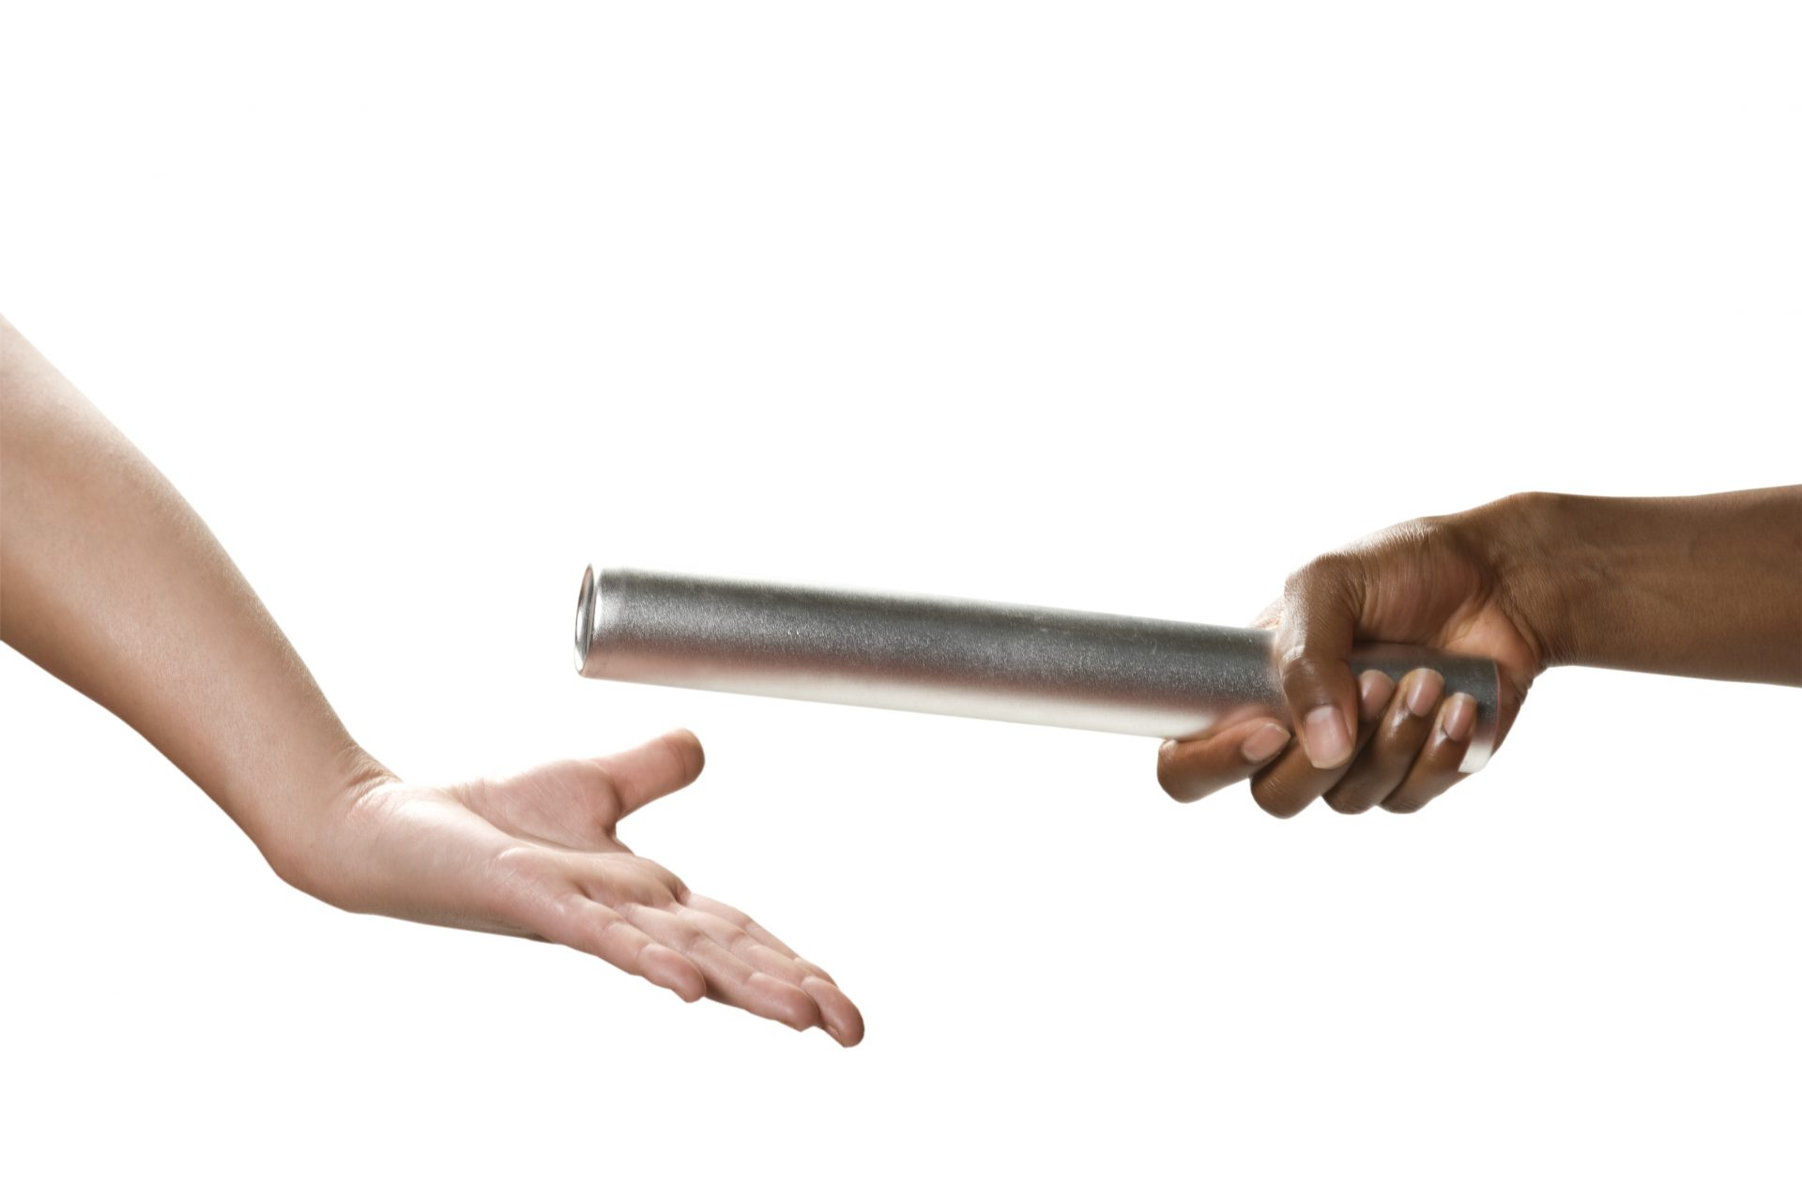
Consider the following during the EMS patient handoff:
The handoff should occur during the EMS timeout, which should last no more than 15-30 seconds.
All personnel in the room should remain quiet during the timeout to receive the EMS report
Questions or clarifications should be requested at the conclusion of the report.
Except for those who are in extremis or arrest, the patient can wait on the EMS stretcher for 30 seconds without harm!

Slide 30
At a minimum, a good EMS patient handoff should include:
Demographics – age, gender, weight
Chief complaint or mechanism of injury with associated s/s
Description of the scene or environmental factors that may have contributed to the illness or injury
Trauma/Medical assessment findings highlighting life threats

Slide 31
At a minimum, a good EMS patient handoff should include:
Vital signs – first set on arrival and repeat/trend if change in status
Summary of patient care interventions and responses
Any critical interventions not yet performed or achieved that should be addressed by accepting team on arrival

Slide 32
Consider utilizing the MIST Format handoff
M Mechanism or Medical Complaint
I Injuries/Illness Identified
S Symptoms and most recent Vitals
T Treatments, Tubes/lines

Slide 33

Texas EMS Wristband Project
The “Why”
To track patients during mass casualty incidents (MCI), evacuations, and disasters
To link pre-hospital and hospital records across disparate electronic medical record systems and throughout the continuum of care
Increase the ability to collect accurate patient information
Expedite record reconciliation and matching across various agencies/systems
Facilitate outcome sharing between prehospital and hospital agencies
Provide time and cost savings in locating and accessing records across multiple systems
The Texas EMS Wristband is for EVERYDAY USE by EMS and HOSPITALS
EVERY patient, EVERY day!

Slide 34
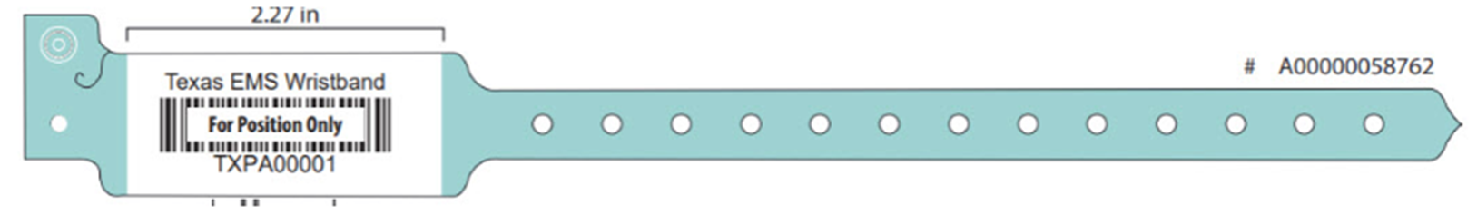
Texas EMS Wristband Expectations
Incoming EMS Patients
When patients are received into a facility with either a Texas EMS Wristband or an EMS Triage Wristband:
Leave the wristband in place and DO NOT REMOVE
Enter the wristband’s unique identifier into a pre-identified query-able field within the facility’s electronic health record
If a wristband is accidentally removed – place a new wristband on the patient, cover or cross out the new barcode & unique identifier, and write the previous wristband’s unique identifier on the new wristband using a permanent marker.

Slide 35
Texas EMS Wristband Expectations
Outgoing EMS Patients
When transferring patients out of the facility:
Place a Texas EMS Wristband on the patient (if one is not already in place)
Enter the wristband’s unique identifier into a pre-identified query-able field within the facility’s electronic health record prior to patient transfer
If a wristband is accidentally removed – place a new wristband on the patient, cover or cross out the new barcode & unique identifier, and write the previous wristband’s unique identifier on the new wristband using a permanent marker

Slide 36

Texas EMS Wristband Expectations
DSHS Rules Requirement
There is expectation that both the Texas EMS & EMS Triage Wristbands will be referenced within the Texas Department of State Health Services (DSHS) Rules, primarily within the revised Trauma Rules, as shown below:
Revised Trauma Rule §157.125: Requirements for Trauma Facility Designation
Section 19, subsection (A); integration of the EMS patient care records, to include the EMS wristband tracking number.
Section 27, subsection (E); The EMS wristband tracking number must be included in the registry abstraction and submission to the State Registry. If a wristband is accidentally removed – place a new wristband on the patient, cover or cross out the new barcode & unique identifier, and write the previous wristband’s unique identifier on the new wristband using a permanent marker
Emergency Medical Services (EMS) Rule §157.11: Requirements for an EMS Provider
Subsection (k); Paragraph (7): EMS vehicles must also have: each vehicle will carry 25 triage tags in coordination with the Regional Advisory Council (RAC).

Slide 37
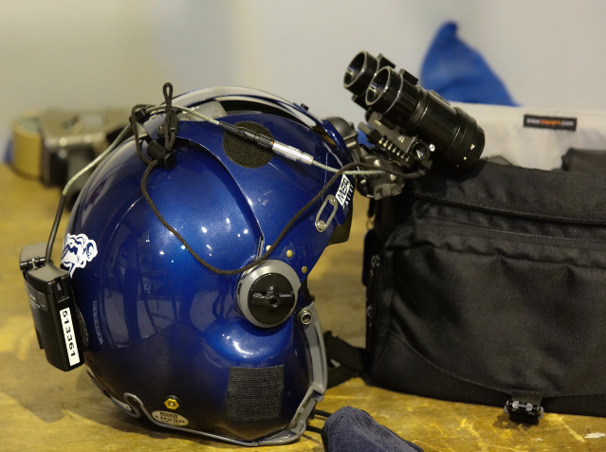
SPECIAL
CONSIDERATIONS
Night Operations
Notes:
Great LZ, Talk through LZ and practice how they would describe the area

Slide 38
NIGHT OPERATIONS CONSIDERATIONS
Decreased visibility
Night Vision Goggles (NVG’s)
  Improves vision
  Can impair depth perception
  Can cause difficulty in differentiating terrain
Light control
  Do not shine light directly into the cockpit or towards the aircraft
  Excessive overhead lights may be problematic
LZ/Helipad lighting is of increased importance
Notes:
Discuss nvg’s, white phos vs. traditional

Slide 39
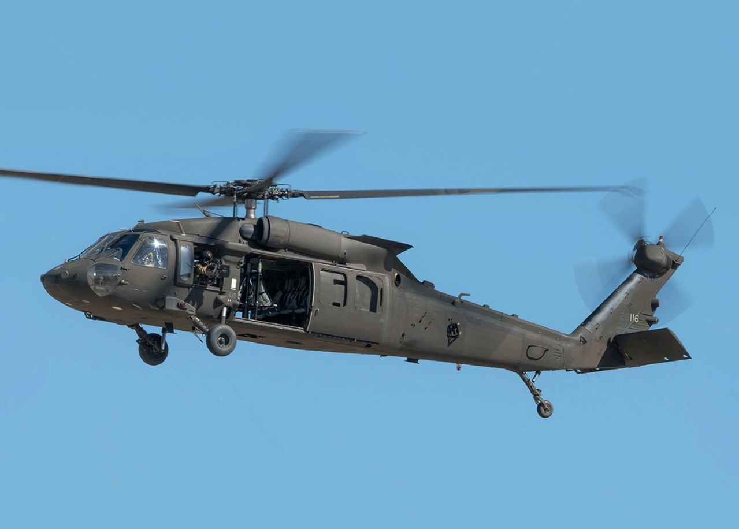
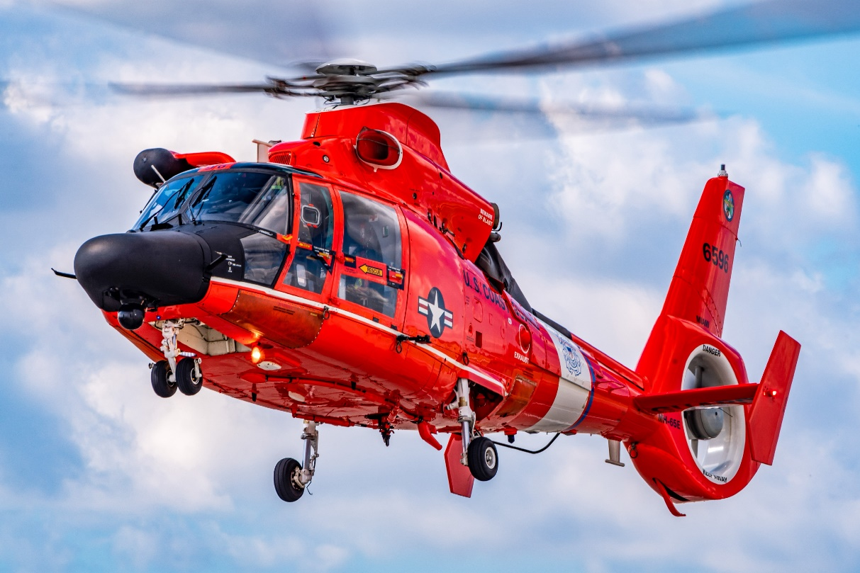
SPECIAL CONSIDERATIONS
Specialty Aircraft
Notes:
Great LZ, Talk through LZ and practice how they would describe the area

Slide 40
SPECIALTY AIRCRAFT CONSIDERATIONS
Regions around Texas may need to consider LZ modifications to accommodate specialty aircraft (MH-65, UH-60, etc.).
Each aircraft/organization may require different LZ and frequency considerations. It is recommended that you consult with applicable departments to best prepare for these specialty aircraft.

Slide 41


LET’S PUT IT ALL TOGETHER
Illinois DOT Hospital Heliport Safety Training - YouTube [youtube.com]
Video utilized with the written permission of the
Notes:
Discuss nvg’s, white phos vs. traditional

Slide 42
SUMMARY
SAFETY IS PRIORITY NUMBER 1!
LZ should be at least 100’x100’, on a flat firm surface, and as free of obstructions/hazards as possible.
A tail rotor guard is essential when the helicopter is on the ground and running.
Clear and concise communication is imperative.
Keep landing areas free of debris.
Anticipate high winds!

Slide 43
SUMMARY
Never approach a running aircraft unless accompanied by the flight crew and/or only when directed to do so.
Stay clear of rotor system during start-up and shutdown.
Secure/remove any loose items.
A good patient care handoff, or “EMS Timeout”, leads to better communication, fewer errors, and easier transitions in the hospital setting.
See a Texas Wristband? SCAN IT!
See a patient without a Texas wristband? PUT ONE ON and SCAN IT!
Risks increase when operating aircraft at night.

Slide 44

CE HOURS
To obtain 1 DSHS CE contact hour for this course, please scan the QR code to complete the exam and evaluation.
Alternately, the following link can be utilized: https://bit.ly/TexasLZ [bit.ly]

Slide 45
LOCAL PROVIDERS
As a reminder, this presentation is not meant as a substitute to in person training with your local providers. GETAC strongly recommends contacting your local air medical provider(s) to schedule that training.
If you require assistance in contacting your local air medical provider(s), please contact your RAC Chair.

Slide 46
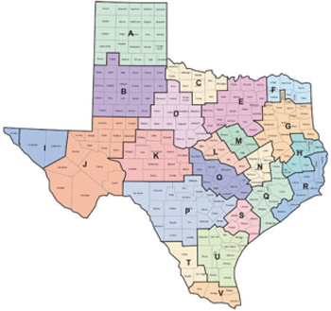
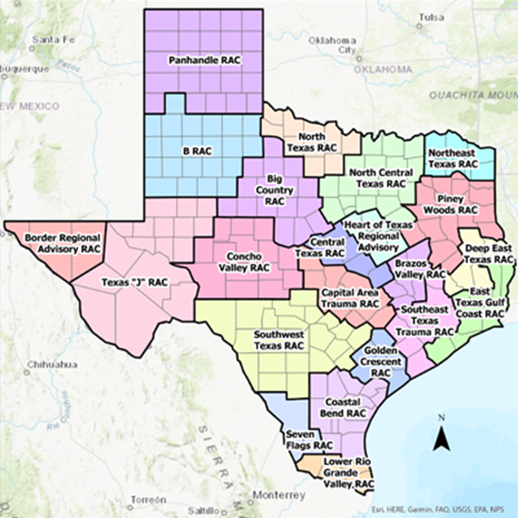
Regional Advisory Councils

Slide 47
Special thanks to North Central Texas Trauma Regional Advisory Council for the presentation template and for their efforts to improve air medical safety.
For questions related to this presentation, please contact Lynn Lail at llail@CareFlite.org

